Slide 1

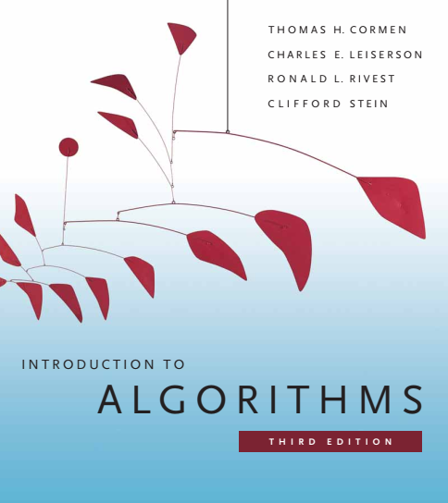
Design and Analysis of Algorithms
Dr. Sajid Iqbal
sajidiqbal.pk@gmail.com
Reference Book
Introduction to Algorithms 3rd Edition By Thomas H. Cormen et. al.
https://mitpress.mit.edu/books/introduction-algorithms-third-edition
COMEDXD

Slide 2
Order Statistics

Slide 3
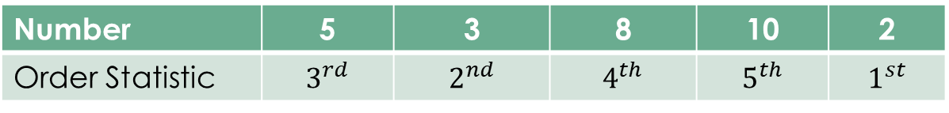

Introduction
$I^{th}$ smallest element in given data is known as $i^{th}$ order statistic
Following table shows the order statistics:
1st order statistic: The minimum element in data
$n^{th}$ order statistic: the maximum element in n-element data
Median order statistic: an element which is present in middle of data when it is in sorted order
If there are odd number of elements, central element is called the median
For even count of data, there are two central elements are medians, first is called the lower median and other is upper median
Number | 5 | 3 | 8 | 10 | 2
Order Statistic | $$3^{rd}$$ | $$2^{nd}$$ | $$4^{th}$$ | $$5^{th}$$ | $$1^{st}$$
5 | 6 | 7 | 8 | 9
5 | 6 | 7 | 8 | 9 | 10

Slide 4

Introduction
Order statistics tends to select and element of $i^{th}$ order statistic
Selection Problem:
Input: A set $A$ with n-distinct elements and an integer $i$ such that $1≤i≤n$
Output: An element $x ε A$ that is on the position of $ith$ order statistic
Selection Problem performs two operations
Sorting the data
Selecting the $i^{th}$ order statistic

Slide 5

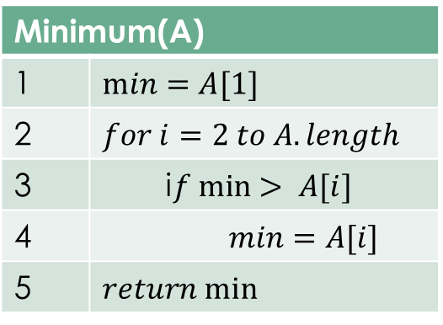
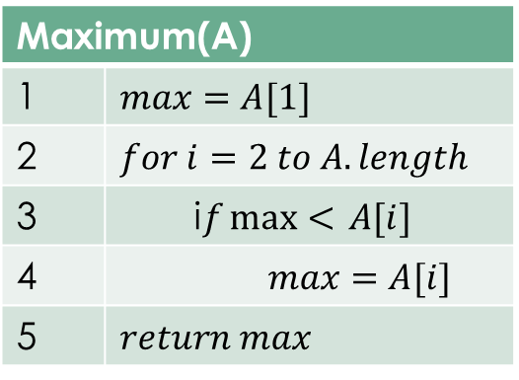
Maximum and Minimum
$There$are two ways to find the min and max
Sort the input array and select the first or last element
Compare element by element to find the min and max using given algorithm
First method may take linear time however second method is guaranteed to take linear time
The time complexity is $θ(n)$
Minimum(A)
1 | $$min=A[1]$$
2 | $$for i=2 to A.length$$
3 | i$f min> A[i]$
4 | $$min=A[i]$$
5 | $$return min⁡$$
Maximum(A)
1 | $$max=A[1]$$
2 | $$for i=2 to A.length$$
3 | i$f\max{<} A[i]$
4 | $$max=A[i]$$
5 | $$return max⁡$$

Slide 6

Selection in Linear Expected Time
Based on logic used in quick sort, Randomize-Selection method is designed
Average case for quick sort takes $θ\left(nlogn\right)$ time
Average case for Randomized Selection takes $θ\left(n\right)$ time
RANDOMIZED-SELECT uses the procedure RANDOMIZED-PARTITION
(please watch the relevant lecture about quick sort for better understanding)

Slide 7
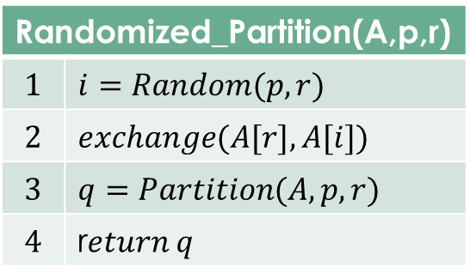
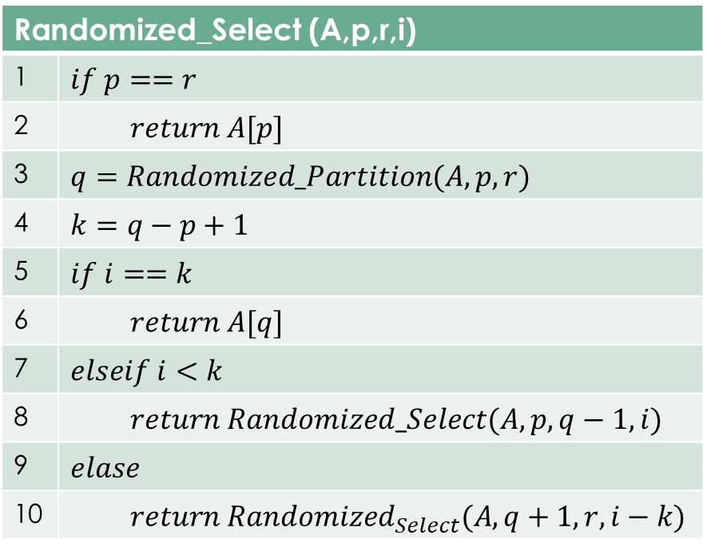
Randomized Selection
Randomized_Select (A,p,r,i)
1 | $$if p==r$$
2 | $$return A[p]$$
3 | $$q=Randomized_Partition(A,p,r)$$
4 | $$k=q−p+1$$
5 | $$if i==k$$
6 | $$return A[q]$$
7 | $$elseif i<k$$
8 | $$return Randomized_Select(A,p,q−1,i)$$
9 | $$elase$$
10 | $$return Randomized_{Select}(A,q+1,r,i−k)$$

Slide 8

Working of Randomized Selection
Line 1: It checks for base case of recursion where array has only one element
Line 2: It returns the only array element
Line 3: It partitions the array into two parts by finding pivot element $A[q]$ such that $A[p,…,q−1]≤A[q]<A[q+1,…,r]$
Line 4: Finds the count of lower sub-array including pivot element
Line 5: Whether $A[q]$ is the $ith$ smallest element
Line 6: return $A[q]$ if Line 5 is true
Line 7: Determine in which sub-array the $ith$ smallest element lies
Line 8: Search in left sub-array
Line 9: other wise
Line 10: search in right sub-array

Slide 9

Time Complexity
Worst case running time of randomized_select is $θ(n^{2})$
Due to randomization, no particular input depicts the worst case
Expected running time
Let T(n) is random variable that describes the running time on an array A with distinct elements
For n-element input, randomized_partition returns the pivot element with probability 1/n
Let $X_{k}$ is random variable
$X_{k}=I\left\{the subarray A\left[p,..,r\right]has exactly k elements\right\}$
$E[X_{k}]=1/n$

Slide 10

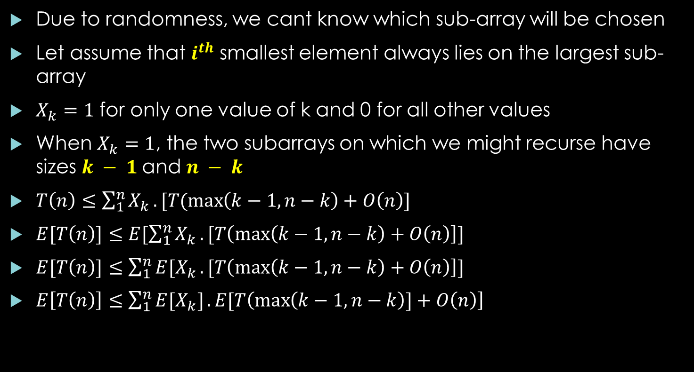
Time Complexity
Due to randomness, we cant know which sub-array will be chosen
Let assume that $i^{th}$ smallest element always lies on the largest sub-array
$X_{k}=1$ for only one value of k and 0 for all other values
When $X_{k}=1$, the two subarrays on which we might recurse have sizes $k − 1$and $n − k$
$T\left(n\right)≤\sum_{1}^{n}{X_{k}}. [T(\max\left(k−1,n−k\right)+O\left(n\right)]$
$E[T\left(n\right)]≤E[\sum_{1}^{n}{X_{k}}. [T\left(\max\left(k−1,n−k\right)+O\left(n\right)\right]]$
$E[T\left(n\right)]≤\sum_{1}^{n}{{E[X}_{k}}. [T\left(\max\left(k−1,n−k\right)+O\left(n\right)\right]]$
$E\left[T\left(n\right)\right]≤\sum_{1}^{n}{{E[X}_{k}]}. E[T\left(\max\left(k−1,n−k\right)]+O\left(n\right)\right]$
$$0−(k−1)$$ | $$K$$ | $$(n−k)$$

Slide 11

$E\left[T\left(n\right)\right]≤\sum_{1}^{n}{{E[X}_{k}]}. E\left[T\left(\max\left(k−1,n−k\right)\right)\right]+O\left(n\right)$
$E\left[T\left(n\right)\right]≤\sum_{1}^{n}{\frac{1}{n}}. E\left[T\left(\max\left(k−1,n−k\right)\right)\right]+O\left(n\right)$
Assume that both arrays of same size then
$E\left[T\left(n\right)\right]≤\frac{1}{n}\sum_{n/2}^{n−1}{E\left[T\left(2k\right)\right]}+O\left(n\right)$
$E\left[T\left(n\right)\right]≤\frac{2}{n}\sum_{n/2}^{n−1}{E\left[T\left(k\right)\right]}+O\left(n\right)$
$E\left[T\left(n\right)\right]≤\frac{2}{n}\sum_{n/2}^{n−1}{ck}+an$
$E\left[T\left(n\right)\right]≤\frac{2c}{n}\sum_{n/2}^{n−1}{k}+an$
$E\left[T\left(n\right)\right]≤\frac{2c}{n}(\sum_{1}^{n−1}{k−}\sum_{k=1}^{\frac{n}{2}−1}{k})+an$

Slide 12

Time Complexity
$E\left[T\left(n\right)\right]≤\frac{2c}{n}(\sum_{1}^{n−1}{k−}\sum_{k=1}^{\frac{n}{2}−1}{k})+an$
$E\left[T\left(n\right)\right]≤\frac{2c}{n}\left(\frac{\left(n−1\right)n}{2}−\frac{\left(\frac{n}{2}−1\right)\left(\frac{n}{2}\right)}{2}\right)+an ∴ \sum_{1}^{n}{k}=\frac{n\left(n+1\right)}{2}$
$E\left[T\left(n\right)\right]≤\frac{2c}{n}\left(\frac{\left(n^{2}−n\right)}{2}−\frac{\left(\frac{n^{2}}{4}−\frac{n}{2}\right)}{2}\right)+an$
$E\left[T\left(n\right)\right]≤2c\left(\frac{\left(n^{1}−1\right)}{2}−\frac{\left(\frac{n}{4}−\frac{1}{2}\right)}{2}\right)+an$
$E\left[T\left(n\right)\right]≤c(\left(n−1\right)−(\frac{n}{4}−\frac{1}{2}) +an$
$E\left[T\left(n\right)\right]≤cn−c−\frac{cn}{4}+\frac{c}{2} +an$
$E\left[T\left(n\right)\right]≤cn$
$E\left[T\left(n\right)\right]=O(n)$

Slide 13

Thanks for watching
Dr. Sajid Iqbal
Assistant Professor
Department of Computer Science
Bahauddin Zakariya University, Multan
sajidiqbal.pk@gmail.com
Slides: https://github.com/sajjo79/Design_and_Analysis_of_Algorithms
YouTube Channel: COMEDXD
Allah Hafiz

